Slide 1
Software Processes
Prof. Dr. Dirk Riehle
Friedrich-Alexander University Erlangen-Nürnberg
AMOS C01
Licensed under CC BY 4.0 International
Notes:
It is Friedrich-Alexander University Erlangen-Nürnberg – FAU, in short.
Corporate identity wants us to say “Friedrich-Alexander University”.

Slide 2
Agenda
Product management
Engineering management
Software development
Quality assurance
Software process models
Plan-driven development
Agile methods

Slide 3
1. Product Management

Slide 4
Product Management
Product management
  Is the management [1] of a company’s products
  Along the product’s life-cycle
  Across the product portfolio (if any)
[1] The purposeful act, manner, or practice of handling, supervising, or controlling [products, product life-cycles, product portfolios]

Slide 5
Product Management (Simplified)
What?
What first?

Slide 6
Two Sides of Product Management
Strategic product management
Focuses on assessing and defining the opportunity
Responsible for the Marketing Requirements Document
Technical product management
Focuses on defining the product and its features
Responsible for the Product Requirements Document

Slide 7
Example Processes and Artifacts
Processes | Artifacts
Opportunity Assessment | Marketing Requirements Document (MRD)
Product Specification | Product Requirements Document (PRD)
Product Roadmapping | Internal Product Roadmap External Product Roadmap
Release Planning | Release Plan

Slide 8
Products vs. Projects
 | Product | Project
Strategic | Strategic product manager | Project leader Senior business analyst
Technical | Technical product manager | (Junior) business analyst

Slide 9
Video From “The Pentagon Wars” [1]
The New Bradley Design
(Ten years in the life of a project manager)
[1] See https://youtu.be/r0op8e0LuoU

Slide 10
Video Lessons
Multiple stakeholders
  Bargaining leads to suboptimal results
Meddling stakeholders
  Intervening in the tank design process
Unclear market
  From US military to foreign markets
Cost explosion
  With changing requirements, costs explode
Inconsistent requirements
  From fast and small to big with firepower
Changing requirements
  Lack of focus invalidates prior work
Feature creep
  From troop carrier to tank

Slide 11
2. Engineering Management

Slide 12
Engineering Management
Engineering management is the management^{[1]} of a company’s product development process [along the product life-cycle] [across a product portfolio]. [DR]
[1] The purposeful act, manner, or practice of handling, supervising, or controlling [developers and engineering processes]

Slide 13
Engineering Management (Simplified)
Who?
By when?

Slide 14
Example Processes and Artifacts
Processes | Artifacts
Release Planning | Release Plan
Resource Allocation | Project Plan Task Board
Outsourcing | Budget Project Plan
Project Retrospective | Note Book

Slide 15
3. Software Development

Slide 16
Software Development
Software development (programming) is the process of turning product requirements into working software. [DR]

Slide 17
Software Development (Simplified)
How?
How fast?

Slide 18
Processes and Artifacts
Processes | Artifacts
Effort Estimation | Release Plan
Programming | Source Code

Slide 19
4. Quality Assurance

Slide 20
Quality Assurance
Quality assurance is the process of assuring that the software being developed has a defined quality. [DR]

Slide 21
Quality Assurance (Simplified)
Releasable?
Good enough?

Slide 22
Quality
The quality of a software system is the degree to which it conforms to its stakeholders’ expectations. [DR]

Slide 23
Stakeholders and Expectations
Product management
  Functional requirements
  Non-functional requirements
Engineering management
  Product quality
  Maintainability and evolution
Support and operations
  Operations costs, usability
  Non-functional requirements

Slide 24
Processes and Artifacts
Processes | Artifacts
Automated Test Design and Implementation | Test Plan Test Code
Manual Test Design and Implementation | Test Plan Test Script
Release Sign-off | Email
Release Packaging | Software Release

Slide 25
Quiz on Organizational Issues
Where in the organizational chart to put product management?
  Sales and marketing
  Engineering
  Stand-alone
Where in the organizational chart to put quality assurance?
  Engineering
  Product management
  Stand-alone

Slide 26
5. Software Process Models

Slide 27
Software Process Model [DR]
A software process
  Is a process performed with goal of creating and evolving software
A software process model
  Is a model of a software process
Software process model elements
  Comprises roles, practices, and artifacts that describe the valid software process instances

Slide 28
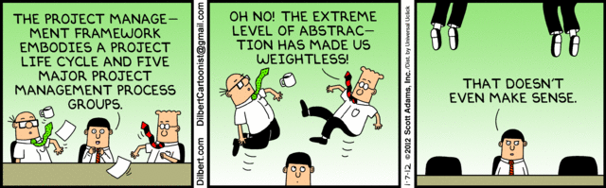
Project Management Frameworks

Slide 29
Key Activities in Software Engineering
Planning
Execution
Review
Release

Slide 30
Example of a Software Product Life-Cycle
incubate
develop
maintain
1st
release
start
mature
retire
I
D
M
I: Incubation
D: Development
M: Maintenance
release
release

Slide 31
(One Version of) The Magic Triangle
Scope
Cost
Time
Quality
Cost is usually assumed fixed (defined team).
Because “adding manpower to a late project makes it later.” [B75]

Slide 32
6. Plan-driven Development

Slide 33
Plan-Driven Development
Linear, phase-oriented, software process models
  Intend to minimize risk through up-front planning
  Expect only one iteration, start to finish, not many
  Equate phases with activities
Examples: Waterfall, V-Modell, RUP
start
Planning
Execution
Review
Release
end
6 months – 5 years
time

Slide 34
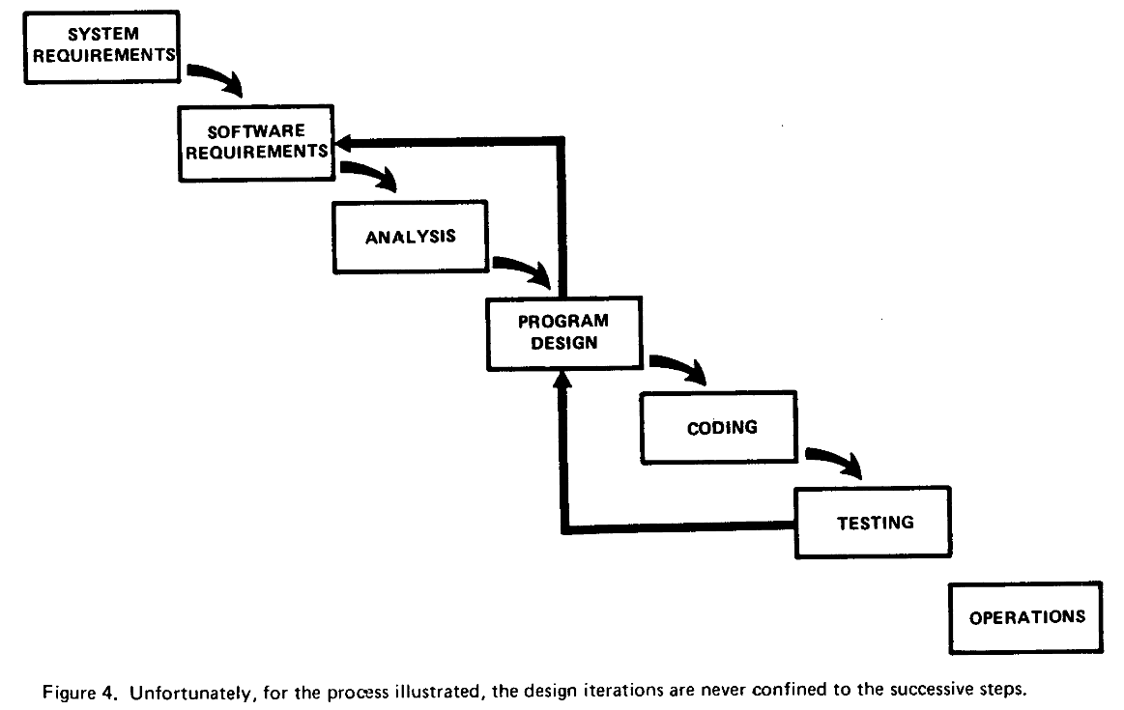
The Waterfall Model [R04]

Slide 35
Aphorisms on Predicting and Planning
“Prediction is very difficult, especially about the future.”
  Attributed to Niels Bohr, date unknown
“Kein Plan überlebt die erste Feindberührung.”
  Helmuth (Karl Bernhard) von Moltke, date unknown
“Plans are worthless, but planning is everything.”
  Dwight D. Eisenhower, Nov 14, 1957

Slide 36
Lesson from Plan-Driven Development
Phases ≠ Activities
(Activity = performing a practice)

Slide 37
7. Agile Methods

Slide 38

Video on Predictability of Processes
[1] See https://youtu.be/D7rbiLNf-JI

Slide 39
Video Lesson
It is impossible to predict such a flight
  Little bumps on the way have big consequences
  Little wind gusts will get you way off track
Executing a plan without steering is dangerous
  There is no way to ensure you will achieve the desired outcome
  Belief in flawless execution is, well, flawed and risky
Also see “the making of Megawoosh” excerpt
  See https://youtu.be/_n065KE00J0

Slide 40
Agile Methods
Invented during the late 1990ties
  In response to failure of plan-driven methods
  Driven by consultants as a significant business opportunity
Repeated iteration over short linear process models
  Defined equal-length iterations with deliverables
  Consistent involvement of users for feedback

Slide 41
Examples of Agile Methods
Scrum
XP (eXtreme Programming)
Adaptive Software Development
The (set of) Crystal Methods
Feature-Driven Development
Pragmatic Programming

Slide 42
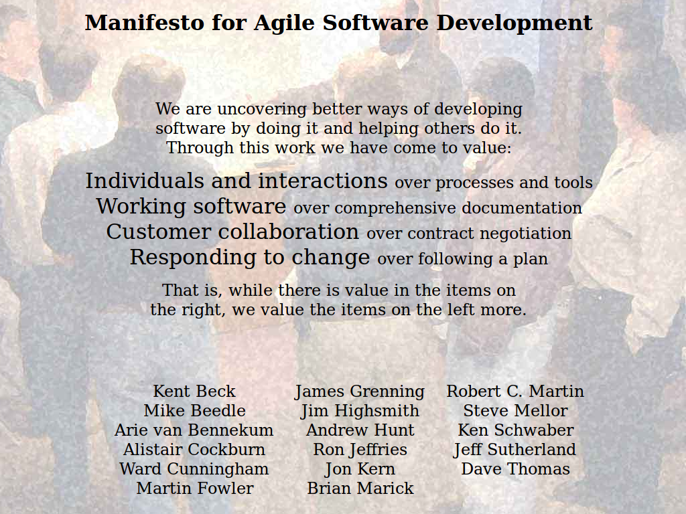

Slide 43
Principles of the Agile Manifesto [A01]
Individuals and Interactions
(over Processes and Tools)
Working Software
(over Comprehensive Documentation)
Customer Collaboration
(over Contract Negotiation)
Responding to Change
(over Following a Plan)

Slide 44
Agile Development Process
Succession of equal-length iterations (“time-boxes”)
Intervention points are during planning and review
User feedback only available during review
Iteration n-1
Iteration n
Iteration n+1
...
...
P
E
3R
P
E
3R
P
E
3R
1-4 weeks
1-4 weeks
1-4 weeks
time
P: Planning
E: Execution
3R: Review, release, and retrospective

Slide 45
Short Iterations and User Feedback
Short iterations
  Short iterations lead to focus on high-value features first
  Established well-worn rhythm is sustainable, avoids burnout
  Partial functionality is better than none
User feedback
  User feedback helps team steer product to meeting needs right
  Feedback loop ensures that problems surface early
  Feedback helps recognize and realize new innovative features

Slide 46
Plan-Driven vs. Agile Processes
T1
S5
T1
Plan-Driven
Agile Methods
T2
T2
S3
T3
S4
T3
S2
T4
T4
S5
S1
S1
T5
T5

Slide 47
Plan-Driven vs. Agile Work Rhythms
Plan-driven methods
Long iterations
time
Agile methods
Short iterations
time

Slide 48
Agile Methods and Discipline
Agile methods
are high-discipline
(more so than plan-driven methods)

Slide 49
Quiz on Types of Projects
Which process model fits Fixed-Price-Projects?
  Plan-driven process
  Agile methods process
  Open source process
Which process model fits Time-and-Materials-Projects?
  Plan-driven process
  Agile methods process
  Open source process
Which process model fits Inter-Firm-Collaboration-Projects?
  Plan-driven process
  Agile methods process
  Open source process

Slide 50
Summary
Product management
Engineering management
Software development
Quality assurance
Software process models
Plan-driven development
Agile methods

Slide 51
Thank you! Questions?
dirk.riehle@fau.de – https://oss.cs.fau.dedirk@riehle.org – https://dirkriehle.com – @dirkriehle
DR

Slide 52
Legal Notices
License
  Licensed under the CC BY 4.0 International license
Copyright
  © 2010-2022 Dirk Riehle, some rights reserved

